Slide 1

AI Methods for business
Amin Shamszadeh
03.03.24

Slide 2

TABLE OF CONTENT
PART ONE: Metacritic Dataset
( unsupervised learning problem)
Introduction
Research Questions
Exploratory Data Analysis
Feature engineering
Dimensionality reduction with PCA
Clustering
Cluster interpretation
Answering research questions using clusters
2

Slide 3

TABLE OF CONTENT
PART TWO: Metacritic Dataset
( Supervised learning problem)
Introduction
Research Questions
Exploratory Data Analysis
Feature engineering
Model evaluation
Explainability: Best performing model
Fitting linear regression, KNN & XGBoost models
Answering research questions
3

Slide 4

INTRODUCTION
PART ONE: Unsupervised
In this research study, we aim to gain insights into the underlying patterns and structures within the Metacritic dataset. To achieve this, we will follow a systematic approach involving exploratory data analysis (EDA), data cleaning, feature engineering, dimensionality reduction using Principal Component Analysis (PCA), K-means clustering, and cluster interpretation and comparison of most suitable method in between K mean and DBSCAN. The overall goal is to uncover meaningful clusters within the data, which can provide valuable information for addressing our research questions.
4
Notes:
4

Slide 5

RESEARCH QUESTION
How can movies be segmented based on their characteristics to identify profit and audience preferences?
SUB-QUESTIONS:
What distinct clusters of movies can be identified based on box office earnings?
How do clusters of movies with high box office earnings differ in their characteristics (e.g., genre, ratings, budget) from those with lower earnings?
5
Notes:
5

Slide 6
Exploratory data analysis and data cleaning
EDA conducted:
Data Loading and Merging: Two datasets, sales_df and meta_df, are loaded and combined based on the 'title' column using an inner join.
Feature Engineering:
A function extract_primary_genre is defined and applied to create a new column primary_genre.
A genre_numeric column is created by mapping genres to unique numeric values.
Similarly, a function extract_rating is defined to create a rating_number column that numerically encodes movie ratings.
Summary Statistics: The describe() function is used to get a summary of statistics for numerical columns in the dataset.
Missing Values:
The code checks for missing values using isna().sum().
Missing values in numerical columns are filled with the median of their respective columns.
Missing values in categorical columns are filled with the mode.
Feature Creation: A new feature benefit is created as the difference between worldwide_box_office and production_budget.
Outliers Detection: Using the Interquartile Range (IQR) method, outliers are detected but not removed; this step only identifies potential outliers.
6

Slide 7
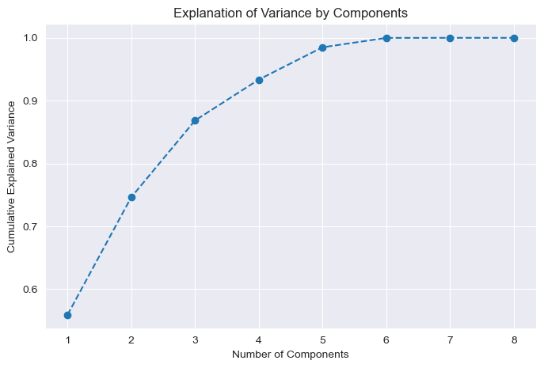
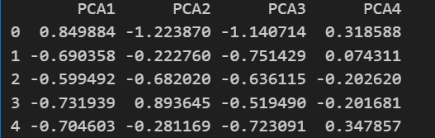
Dimensionality reduction with PCA (Principal Component Analysis)
PCA is performed on the standardized data, and a plot of cumulative explained variance ratio is created to determine the number of components to retain.
The final PCA is conducted with 4 components which entails more than 90% of variance
7

Slide 8
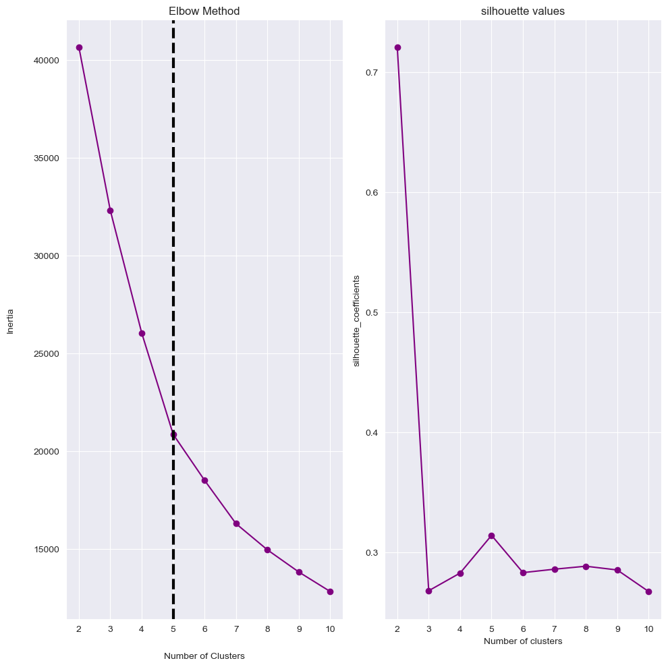
Clustering
Finding the optimal number of clusters using the elbow method and silhouette value
Elbow method and silhouette scores are calculated to find the optimal number of clusters.
K-Means is applied to the PCA-transformed data to group movies into clusters.
Number of clusters is concluded from the plots which is 5.
8

Slide 9
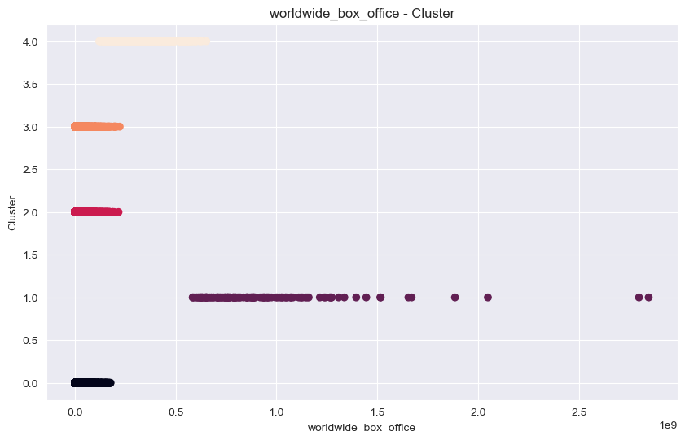
Cluster interpretation & Answering research questions using clusters
SUB QUESTION 1:
What distinct clusters of movies can be identified based on box office earnings?
Clusters identified and analyzed and in terms of box office earnings cluster number 1 has the highest rate of sales.
9

Slide 10
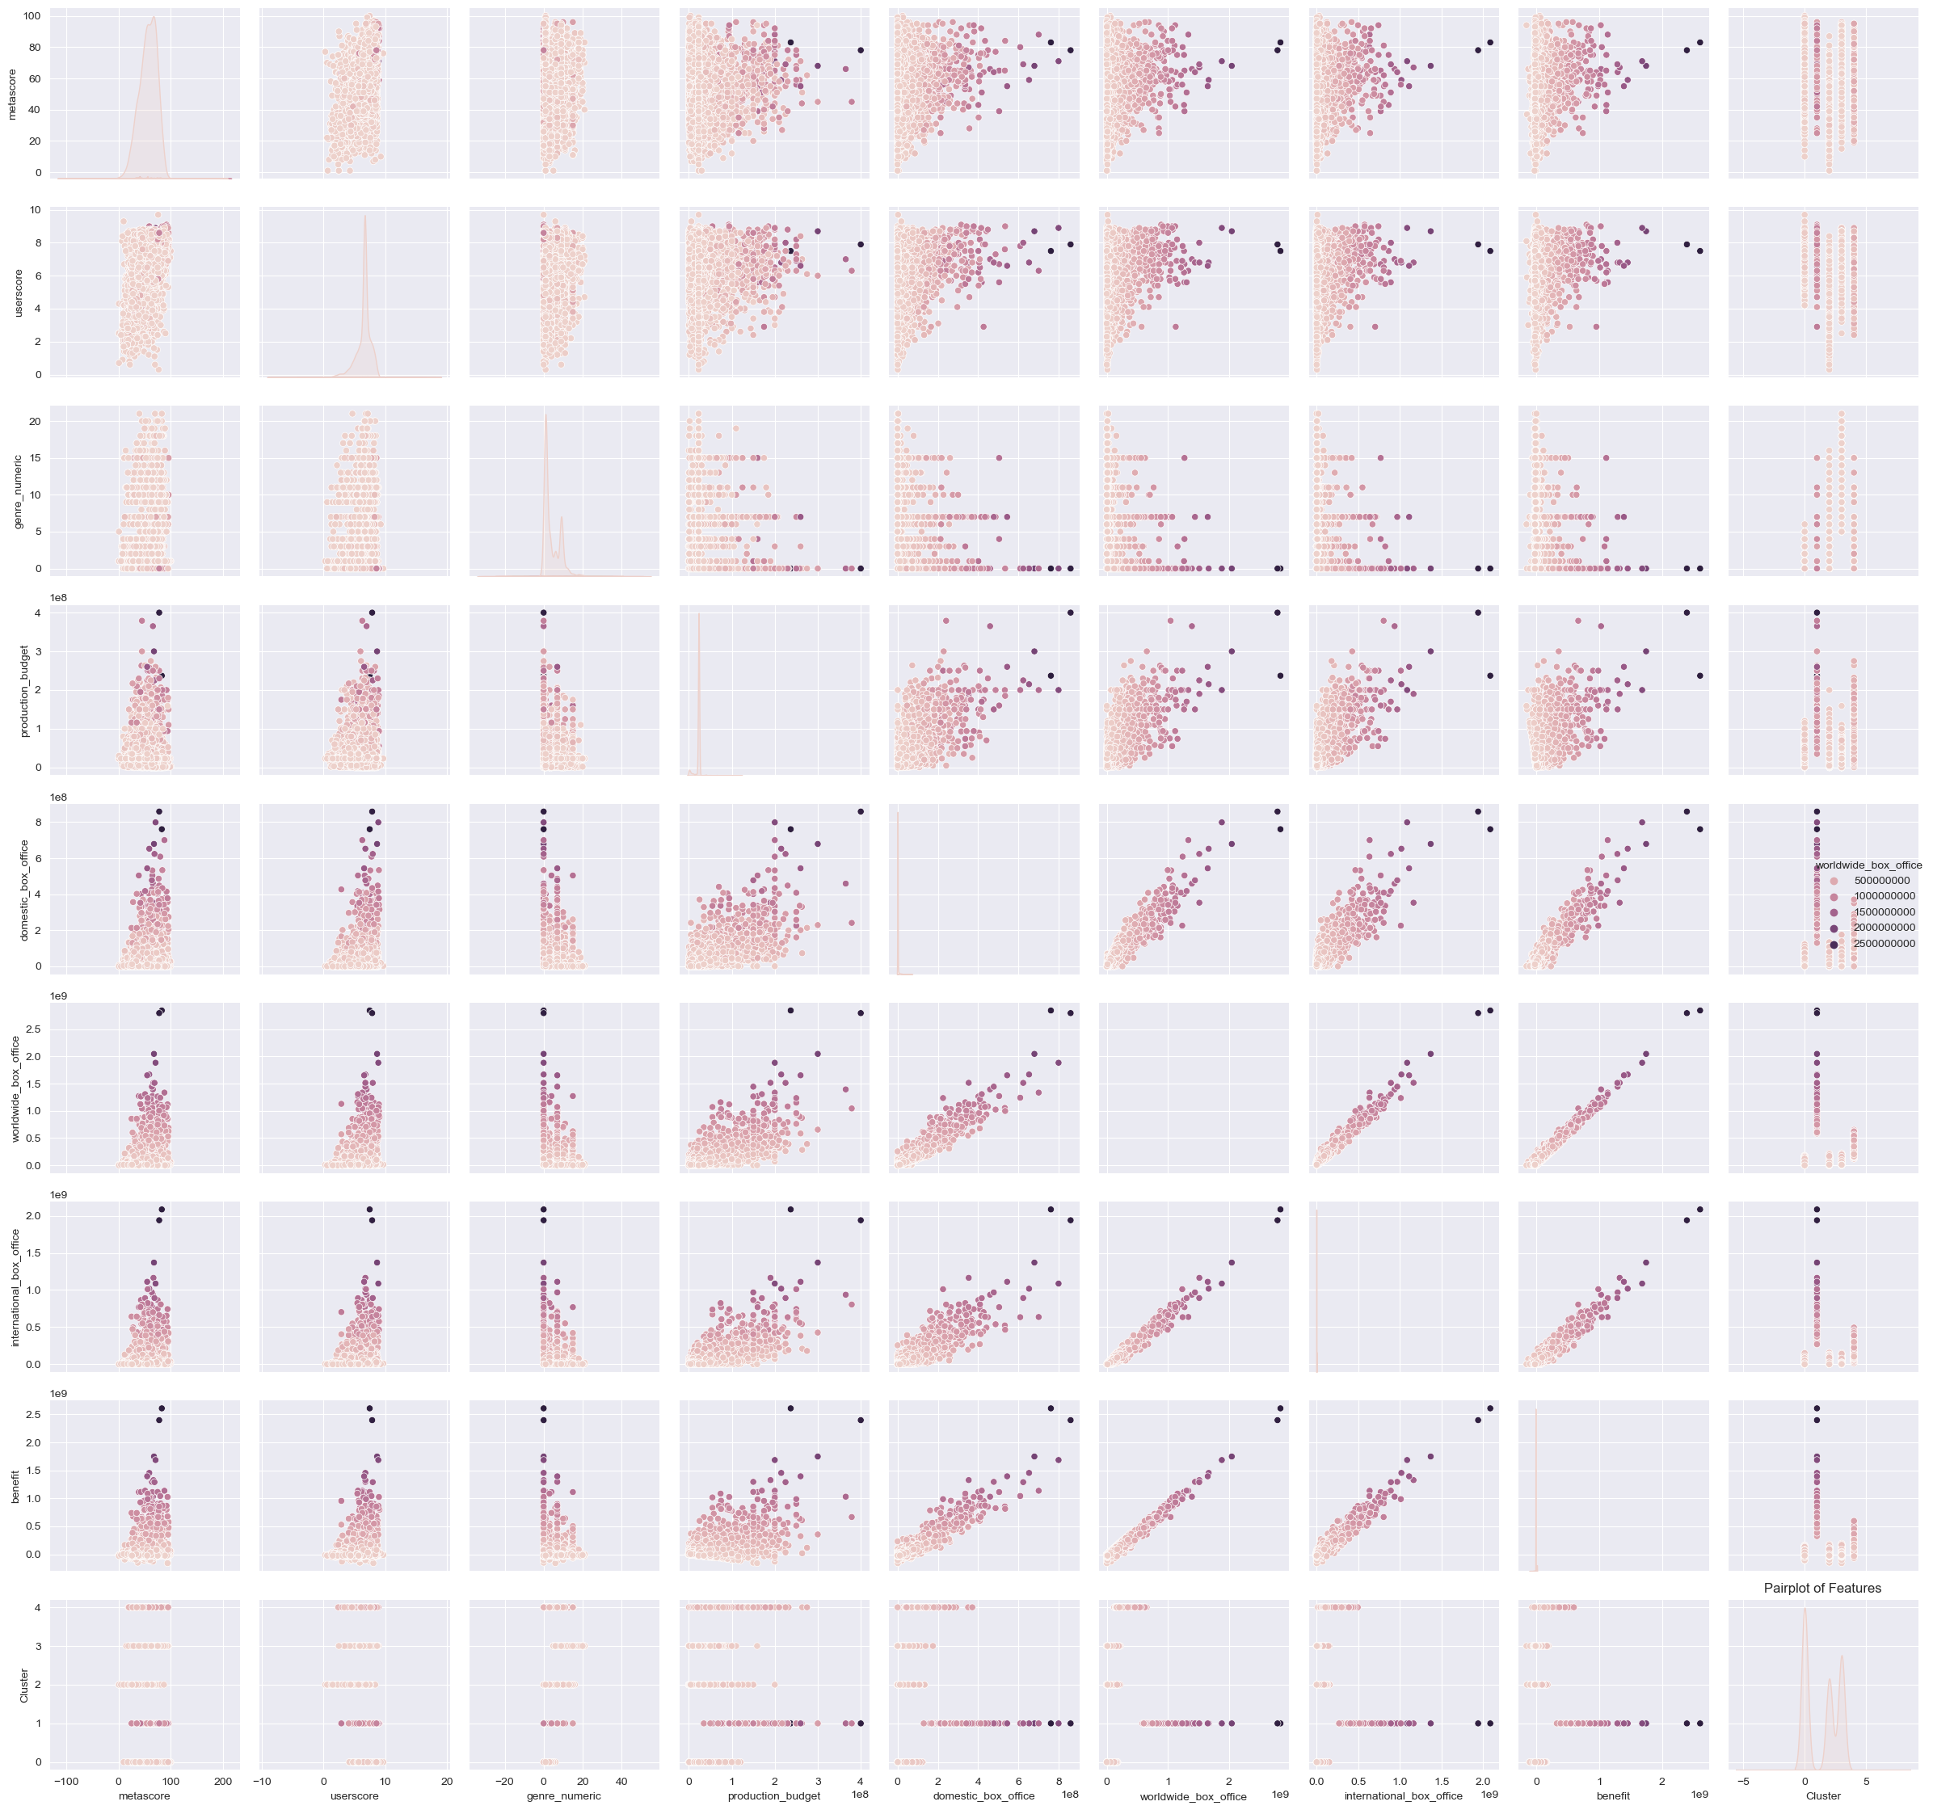
SUB QUESTION 2:
How do clusters of movies with high box office earnings differ in their characteristics (e.g., genre, budget) from those with lower earnings?
The films with higher user and customer score usually have higher sales
The more budget dedicated, the more sales earned
Action, Adventure, fantasy are top 3 genres that has highest sales
For the full size and visible version, please view the notebook.
10

Slide 11
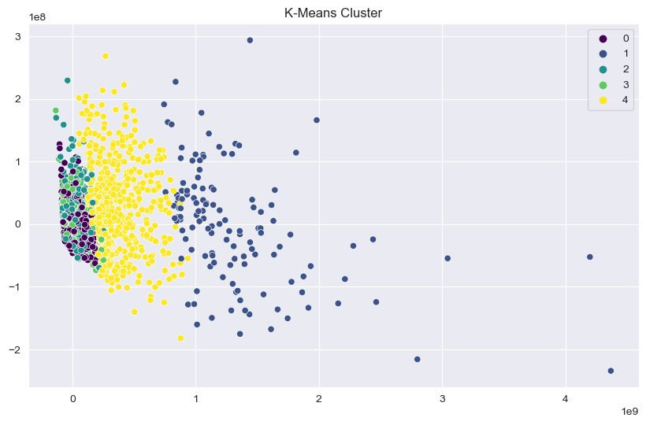
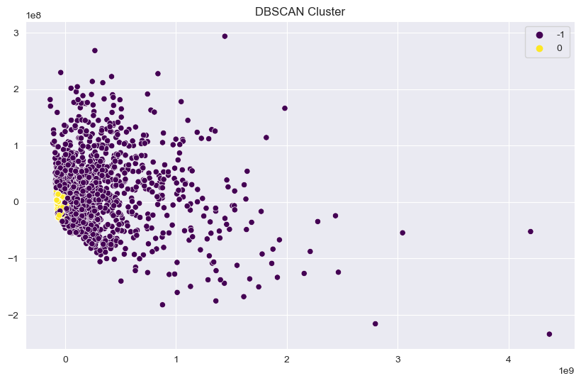
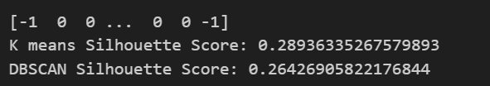
K-mean or DBSCAN
At the final stage, I compared the K mean clustering with DBSCAN which is another highly used method to identify which one performs better for my business questions.
K mean score indicates that it is a bit more suitable for our analysis.

Slide 12
INTRODUCTION
PART TWO: Supervised
In this research study, we aim to gain insights into the details of Metacritic dataset, employing a comprehensive approach that encompasses exploratory data analysis (EDA), data cleaning, feature engineering, dataset generation, model fitting, evaluation, selection, and interpretability. Our primary objective is to develop robust predictive models, specifically employing both random forest and neural network models, to understand the factors that can influence the sales of movies and the profit of them.
12
Notes:
12

Slide 13
RESEARCH QUESTION
What are the key predictors of a movie's financial success and audience reception?
SUB-QUESTIONS:
How well can the success of a movie, in terms of domestic and international box office earnings, be predicted based on its pre-release variables (budget, genre, ratings)?
Can we predict the audience reception (userscore) of a movie based on its genre, budget, and critical reception (metascore)?
13
Notes:
13

Slide 14
Exploratory data analysis and data cleaning
Data Preparation:
Features (X) and target variables (y) are selected from the scaled data.
The data is split into training (X_train, y_train) and testing (X_test, y_test) sets, typically used for training models and evaluating their performance, respectively.
Model Training:
Various regression models are initialized, including Random Forest (RandomForestRegressor), Neural Network (Sequential from Keras), Linear Regression (LinearRegression), KNN (KNeighborsRegressor), and XGBoost (XGBRegressor).
Grid search (GridSearchCV) is used for hyperparameter tuning to find the best parameters for Random Forest, KNN, and XGBoost models based on cross-validated mean squared error (MSE).
After finding the best parameters, the models are trained on the training data.
Model Evaluation:
The trained models are used to predict the target variable on the test set.
Performance metrics like mean squared error (MSE), mean absolute error (MAE), and R-squared are calculated to evaluate the models' predictions.
For the Neural Network model, callbacks like EarlyStopping and LambdaCallback are used to prevent overfitting and print the loss after each epoch, respectively. The model is trained for a set number of epochs with early stopping if the validation loss does not improve.
14

Slide 15
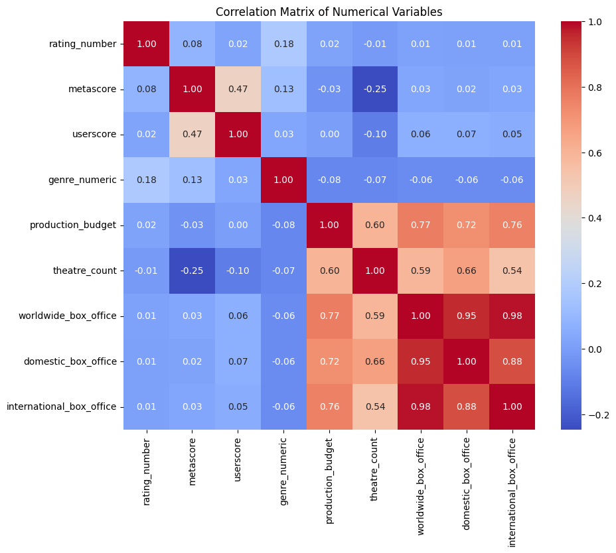
Correlation analysis
Rating Number: It doesn't have a strong correlation with any other variable, indicating that the numerical encoding of ratings does not linearly relate to box office numbers or other factors listed here.
Metascore and Userscore: These have a moderate positive correlation with each other (around 0.47), suggesting that critics' ratings (metascore) and audience ratings (userscore) often agree to some extent.
Production Budget and Box Office Figures: There's a strong positive correlation between production budget and various box office figures (worldwide, domestic, and international), ranging approximately from 0.72 to 0.77. This suggests that movies with higher production budgets tend to have higher earnings, which could be due to various factors such as better production quality, casting, marketing, etc.
Theatre Count and Box Office Figures: Similar to the production budget, the theatre count has a strong positive correlation with box office figures, which implies that movies shown in more theatres generally earn more at the box office.
Domestic vs. International Box Office: There's a very strong positive correlation (0.98) between domestic and international box office earnings, indicating that movies that do well domestically also tend to perform well internationally.
Worldwide Box Office: It is highly correlated with both domestic and international box office figures (0.95 and 0.98, respectively), which makes sense because the worldwide figure is a sum of both.
15

Slide 16
Model evaluation
Random Forest Regressor Model
1. Model Performance Metrics:
- The Mean Absolute Error (MAE) of 0.0240 is quite low, which indicates that on average, the predictions deviate from the actual values by this small amount.
- The R-squared Score of 0.9807 is relatively high, suggesting that the model explains approximately 98.07% of the variance in the target variable, indicating a strong model performance.
16

Slide 17
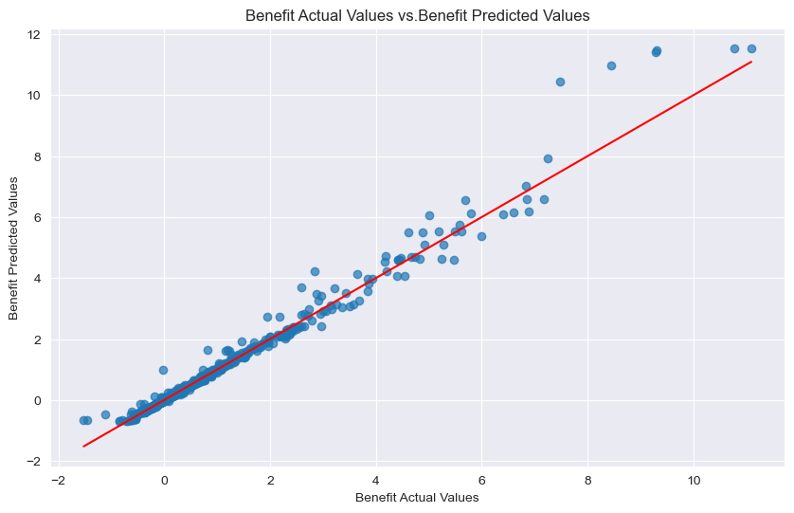
Model evaluation
Random Forest Regressor Model
Scatter Plot Insights:
- The scatter plot of actual vs. predicted values shows a concentration of points along the red diagonal line, which implies that many predictions are close to the actual values.
- There is some spread away from the diagonal line, indicating areas where the predictions are less accurate.
17

Slide 18
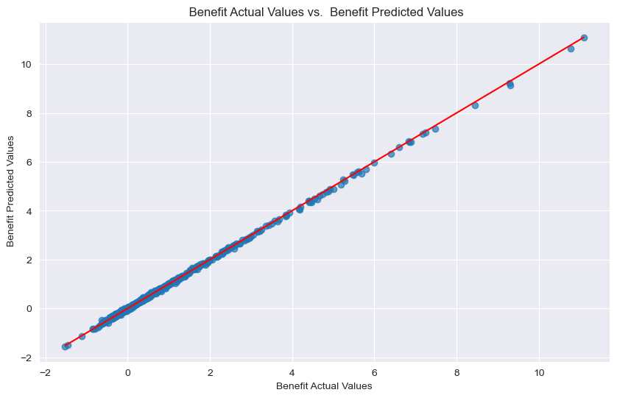
Model evaluation
Neural Network
1. Model Performance Metrics:
- The Mean Absolute Error (MAE) for the neural network is 0.1754, which is lower compared to the Random Forest model's MAE.
- The R² Score for the neural network is 0.9993, a bit higher than the Random Forest model, indicating that the neural network explains more variance of the target variable and is more accurate in predictions.
18

Slide 19

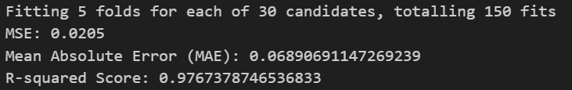
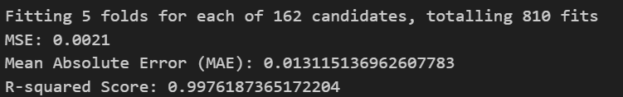
Model evaluation
LinearRegression
\
KNN Regression
Xgboost
19

Slide 20


Answering sub question 1: how well the success of a movie, in terms of international box office
earning, be predicted based on its pre-realese variables( budget,genre,retings)?
Based on the evaluation the top 3 mentioned factors has almost 62% influence on International Box office sales.
20

Slide 21


Answering research questions
Answering sub question 2: can we predict the audience reception (user score) of a movie
based on its genre, budget, and metascore?
Based on the findings by evaluation, there is almost quarter of the chance that we can predict user score by the features mentioned.
21

